Slide 1
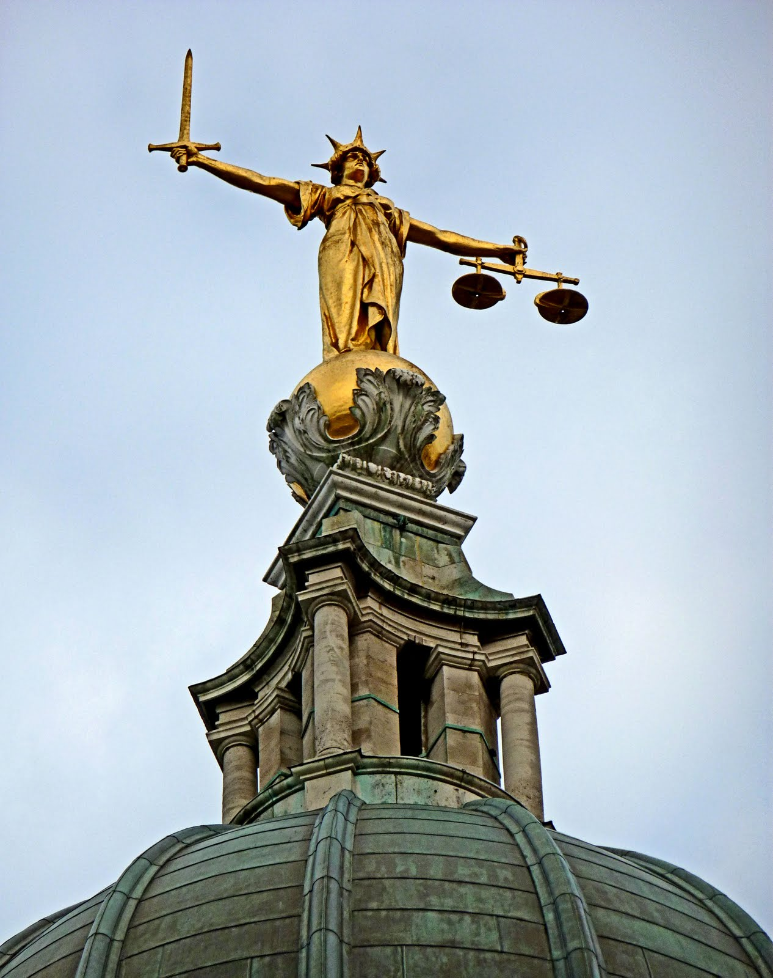
Fair Play Theory
Introduction to Political Theory
Dr. Billy Christmas
Lecturer in Political Theory

Slide 2
Fair Play Theory
We benefit from government, so it is only fair that we cooperate with it
Does it provide a plausible grounds for political authority?

Slide 3
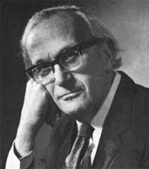
The Principle of Fairness
[W]hen a number of persons conduct any joint enterprise according to rules and thus restrict their liberty, those who have submitted to these restrictions when required have a right to a similar submission from those who have benefited by their submissions.
(H. L. A. Hart, “Are There Any Natural Rights?” Philosophical Review 64 , 1955)

Slide 4
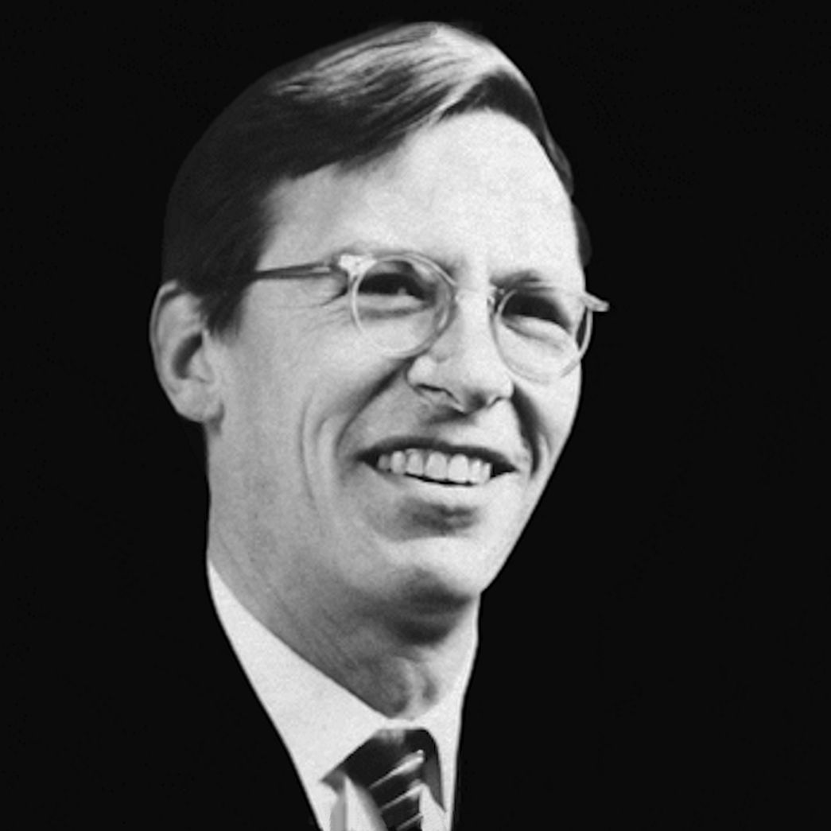
The Principle of Fairness
“We are not to gain from the cooperative labors of others without doing our fair share.”
(John Rawls, A Theory of Justice, 1971)

Slide 5

From Fairness to Political Authority
→ Fairness demands that we cooperate in endeavors that we benefit from
→ The obligation is owed to the other cost-bearing cooperators
This obligation is cashed out as a duty to obey the state
The state (or rule of law) itself is regarded as a beneficial endeavor

Slide 6
Excludable Goods vs. Non-Excludable Goods
Not merely about positive externalities
Not that there are knock-on benefits to others as a side-effect, but that others actually receive the good itself

Slide 7
Excludable Goods
E. g.
University education
Tube rides
Hotel stays
Dinner at my house

Slide 8
Excludable Goods
Principle of Fairness Applies Easily to Excludable Goods
Since you can exclude yourself from receipt of benefits, if you don’t want to contribute, you can simply forgo the benefits
Cooperative endeavors become akin to voluntary associations (duty to contribute is almost consent-based)
Voluntary receipt could be construed as voluntary acceptance of burdens of participation

Slide 9
Non-Excludable Goods
E. g.
National defence
Pollution remediation
Rule of law – most important one!
NOT infrastructure!

Slide 10
Non-Excludable Goods
Does principle of fairness apply?
You did not voluntarily receive the benefits, why should bare costs?
“Limiting argument”: fairness only implies obligation when it comes to excludable goods

Slide 11
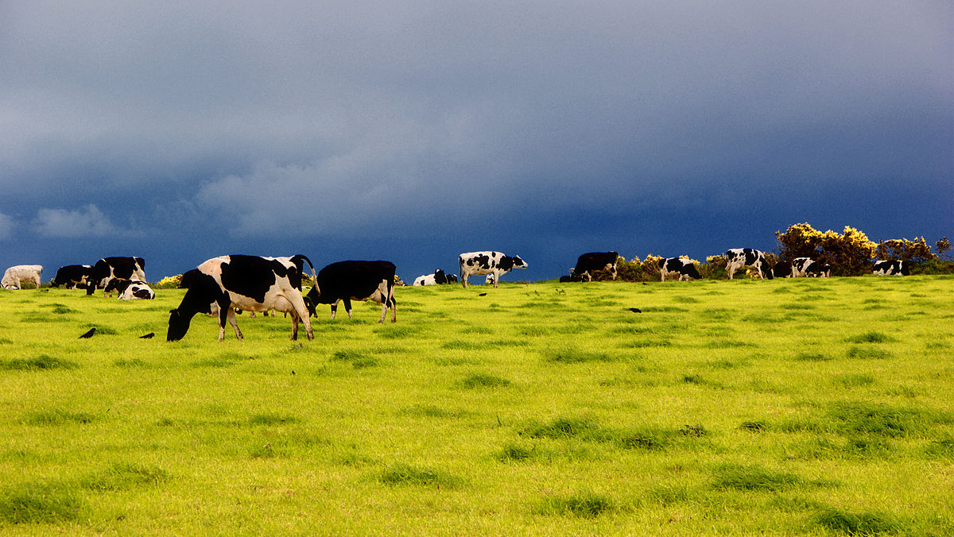
Garret Hardin, “Tragedy of the Commons” Science, 162 (1958)

Slide 12
Non-Excludable Goods
Problem: non-excludable goods are subject to the Tragedy of the Commons/Free-Rider Problem:
Since use is open to everyone, it may be overused
Unless people can be made to contribute, it will be depleted/under-provided

Slide 13
Non-Excludable Goods
Enforcement of fairness obligations might be necessary for such goods to exist at all
But is this justifiable – is there a real moral obligation to contribute?

Slide 14
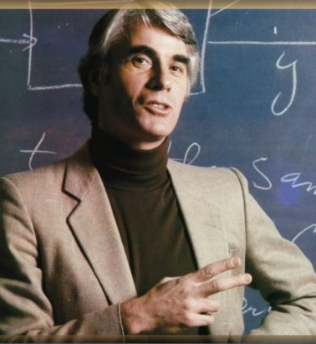
Nozick Says “No”
Examples:
Neighborhood PA system
Neighborhood street sweeping
Fairness does not override the need to get people’s consent before they are forced to cooperate

Slide 15
Nozick Says “No”
“One cannot, whatever one’s purposes, just act so as to give people benefits and then demand (or seize) payment. Nor can a group of persons do this.”
(Anarchy, State, and Utopia, 1974, p. 95)
Perhaps even more serious when it is not money but actual labour

Slide 16

Enforceability
Obligation to obey the state is (purportedly) enforceable
One might agree with fair play duties in these cases, but not think they’re enforceable
But the moral obligation would need to be very strong to be legitimately enforceable

Slide 17

Refining the Principle
George Klosko:
Nozick is right with regard to those cases, but those goods are trivial
Where cooperative schemes provide significant benefits, fairness implies obligation

Slide 18
Refining the Principle
George Klosko:
The non-excludable goods in question must be
Worth the recipients' effort in providing them
Presumptively beneficial

Slide 19
Presumptive Benefits
Things that you want, whatever else you want
Indispensable, multi-purpose goods
E. g. freedom; security
Rawlsian “primary goods”?

Slide 20
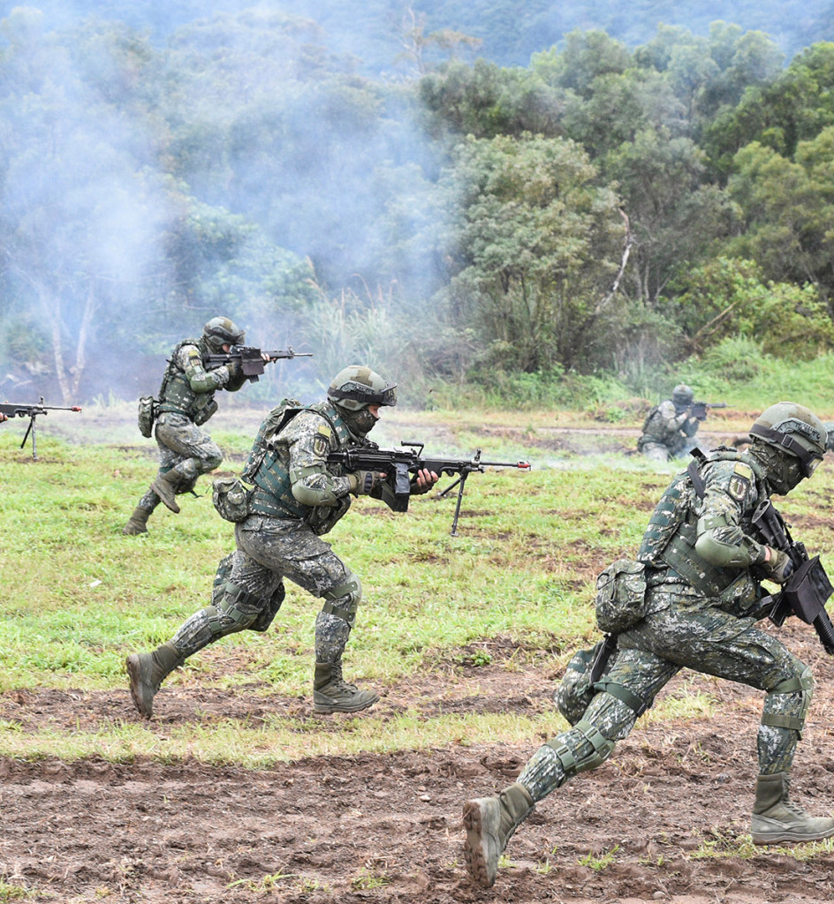
Case One: Security from Imminent Threat
A is an inhabitant of X; a small territory surrounded by hostile neighbors intent on massacring the population
X-ites institute a sophisticated military which is necessary and sufficient for the protection of X from hostile outsiders
This institution depends upon every able-bodied X-ite of age spending at least a year doing military service
Klosko: surely, A has an obligation to undertake the burden of military service

Slide 21
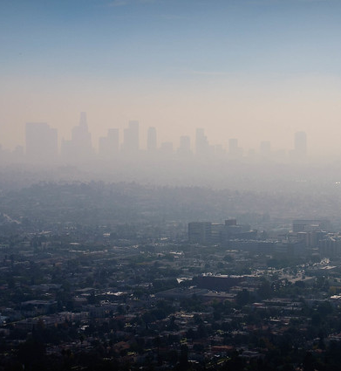
Case Two: Pollution Mitigation
B lives is an ecologically isolate territory, Y, which is beset by severe air pollution (it is causing and exacerbating serious lung conditions)
Y-ites band together to impose reasonable and effective restrictions on pollutants (mainly, the use of cars), and require cars to be altered to make them less polluting
These restrictions are costly and inconvenient to B, so she does not want to comply with them
Klosko: surely, she has an obligation to bear these burdens

Slide 22

Case Three: Human Vivisection
A society conducts scientific and medical experiments on humans
The benefits (assume them to be non-excludable), are enormous and presumptive
Members of this society are not obliged to participate because the cost is too high (pain, severe illness, death, etc.)
→ Cost to individual participants must not be greater than the benefits to the individual

Slide 23
Refinement of Principle
Recall:
Non-excludable
Presumptive benefits
Worth the cost to the individual
Also:
Internal distribution of benefits and burdens within the cooperative endeavor but itself be fair
Fairness cannot oblige you to take part in an internally unfair system
E. g. (1) if there was racial discrimination within the ranks of the military; or (2) rich people were allowed to pollute more than poor

Slide 24
Political Authority
Fairness obliges you to contribute to provision of presumptive public goods
Not discretionary public goods (goods that only happen to benefit some people)
Can only ground authority of a minimalist government
Klosko: actually, it can go further

Slide 25
Bundling
What if provision of a discretionary good is bundled with provision of other discretionary goods, such that everyone benefits?
The overall bundle is presumptively beneficial → obligation?
Klosko: no combination of discretionary goods “adds up” to a presumptive good. Therefore, not strong enough to yield obligation
It is not merely that one benefits, but that one couldn’t do without the benefit, that does the work

Slide 26
Bundling
What if provision of a discretionary good is bundled with provision of a presumptive good?
Moral difference in creating an obligation vs. maintaining one
Do you lose your obligation now that a discretionary good is being provided?
Only if it renders
the distribution of benefits and burdens unfair;
or makes the presumptive benefit not worth the cost

Slide 27
Klosko’s Conclusion
Only if it renders
the distribution of benefits and burdens unfair;
or makes the presumptive benefit not worth the cost

Slide 28
Klosko’s Conclusion
Therefore, you have an obligation to governments iff they provide at least one presumptive public good
And if it provides discretionary public goods, funded and distributed in a fair way

Slide 29
Klosko’s Conclusion
Provision of private goods would extinguish all authority
Cannot benefit particular persons based on who they are: all goods must be non-excludable

Slide 30
Rawlsian Authority
Liberty Principle = presumptive public good of secured freedom
Difference Principle = governs fair distribution and funding of discretionary public goods

Slide 31
A Note on Thought Experiments
Abstractions from distracting, complicating, or prejudicing information that are present in the empirical reality
Prime more trustworthy intuitions
Important to identify which intuitions are giving you the conclusion you draw

Slide 32
Case Two: Pollution Mitigation
Possible grounds for skepticism:
Intuition is driven by a Harm Principle, not a duty of Fair Play
E. g. J. S. Mill’s liberalism
The duty imposed is a negative duty not a positive duty
Tells you not to actively harm others, does not require enforcement of any particular actions
Political authority involves positive obligations, not merely negative ones, so not clear that a Harm Principle could ground political authority

Slide 33
Case One: Security from Imminent Threat
Possible grounds for skepticism:
Intuition is driven by Rescue Duty, not duty of Fair Play
E. g. Peter Singer’s Drowning Baby Case
Would need to make the case that political authority is necessary to avoid imminent threats to innocent life

Slide 34

Next Week: Natural Duty Theory
Thank you!

